Slide 1
Open Data & Libraries
Open Data Literacy Project
Washington State Library, Summer 2018
Kathleen Sullivan, intern

Slide 2
Background
Open data from government sources can advance transparency, efficiency and innovation, but the current system isn’t robust.
As institutions dedicated to information quality, access and literacy, libraries have the potential to boost open data supply and demand. Research about libraries’ open data role is thin.
The Washington State Library supports libraries across the state, and can easily disseminate research findings and best practices.

Slide 3
Research questions
What open data activities are public libraries engaged in? What activities would they like to undertake in the future?
How many Washington State localities now publish open data?
How might the Washington State Library support open data through public libraries?

Slide 4
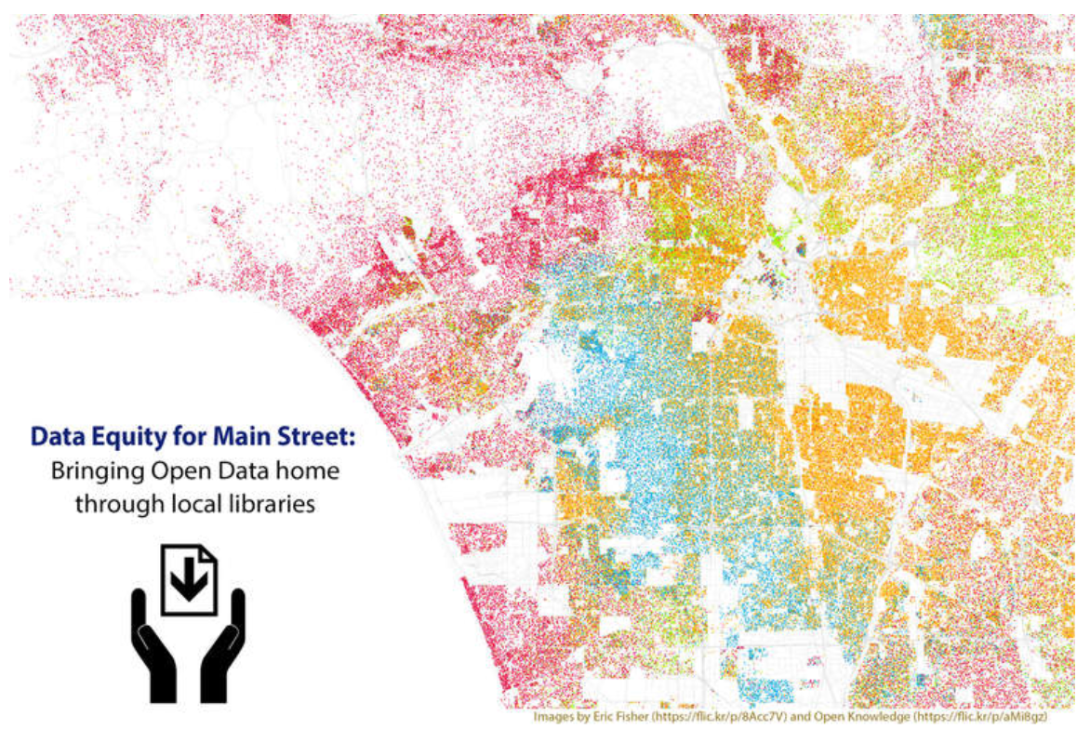
Methods
Interviewed staff from 10 libraries participating in Data Equity for Main Street (7 in WA, 3 in CA)
Interviewed or reviewed websites of 12 other Washington State public library systems
Asked about service populations, and whether libraries published, taught or advised local agencies about open data

Slide 5
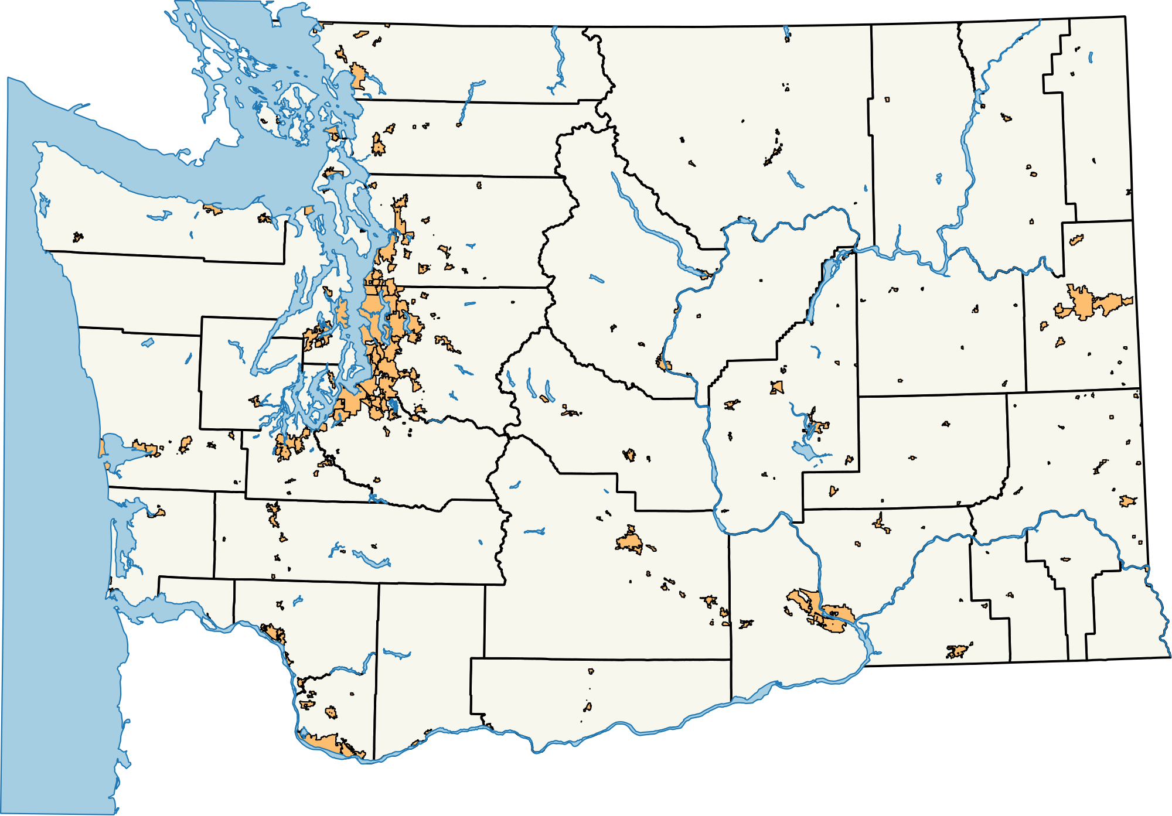
I also surveyed local open data publishing
Washington State’s 39 counties + largest city in each county

Slide 6
Findings
What open data activities are public libraries engaged in? What activities would they like to undertake in the future?

Slide 7
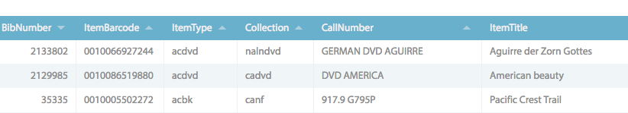
Findings: Libraries as publishers
Just two libraries were publishing any open data. A few more had open data in the pipeline.
Other libraries were interested in publishing, if they had infrastructure, tips and other support.
Libraries face the same challenges as any other publisher – time constraints, privacy and security concerns, anxiety about misinterpretation.

Slide 8
Findings: Libraries as educators
Most Data Equity libraries had already conducted classes for the public or staff, although a few were planning classes for Fall 2018.
Just one non-Data-Equity library had offered open data instruction.
One Data Equity library used curriculum to train local city department heads, ahead of a city portal launch.

Slide 9
Findings: What went well with public open data classes
Strong connection to library mission – access, literacy, critical thinking, participation in democratic process
Overall positive feedback
Content is solid and can be tailored to particular audiences
Good strategic planning: Thriving libraries explore new tools

Slide 10
Findings: Challenges in public open data classes
Attendance, even after vigorous outreach
Classes for service population, vs. just-in-time

Slide 11
Findings: Open data staff training a home run
High attendance & enthusiasm
Informal signs of continued use – emails, requests for more classes
Widespread agreement that reference librarians should be familiar with open data sources and tools, and ready to direct patrons to open data one-on-one, as needed.

Slide 12
Findings: Libraries as advisors
Two Washington State public libraries are working with city governments to launch or improve open data.
One large California public library already works with its city on education, emergency planning and digital privacy, and intends to work with the city to improve its open data portal.
Half a dozen other library systems expressed interest in working with local government on open data, or even providing open data portals themselves.

Slide 13
Findings: What makes libraries natural open data advisors?
User experience experts: Libraries interact with the public daily and understand how real people seek and use information
Long experience using data to demonstrate value
Culture friendly to technology and open information

Slide 14
Findings
How many Washington State localities now publish open data?

Slide 15
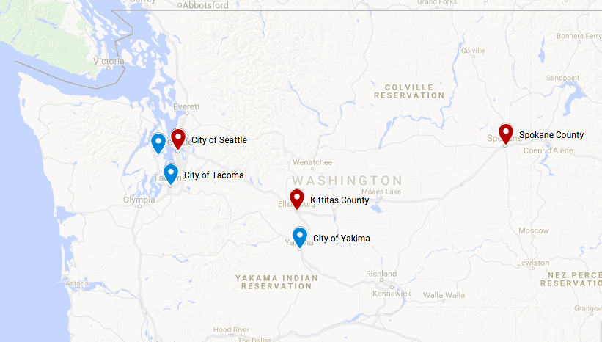
Findings: Local open data is thin
27 counties and 10 cities surveyed publish open data of some kind
Overwhelmingly GIS, and most presented in DIY formats
Only a few localities were publishing anything other than maps and parcel information

Slide 16
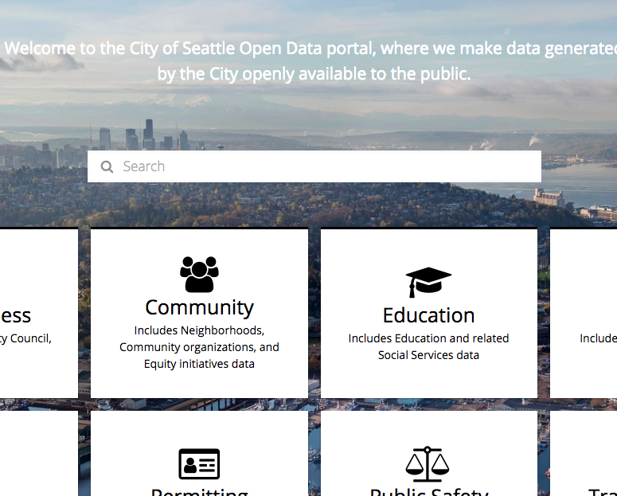
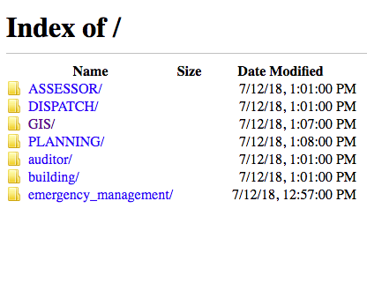
Findings: Local open data presentation ranges
from this…
…to this

Slide 17
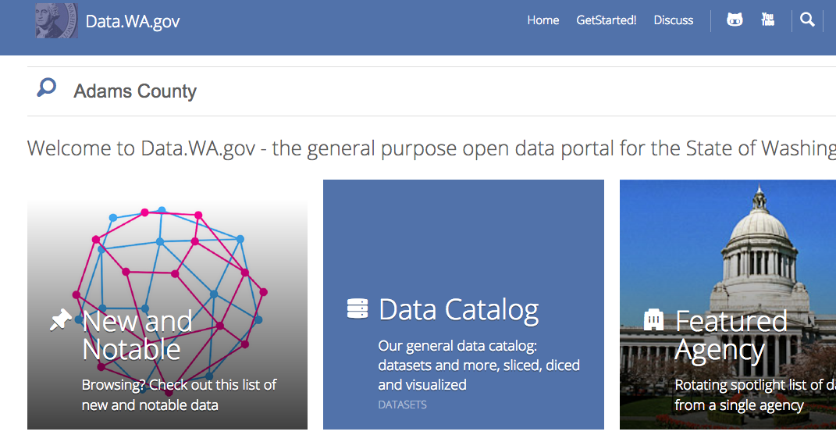
Findings: You can still find data about localities, just not from localities themselves

Slide 18
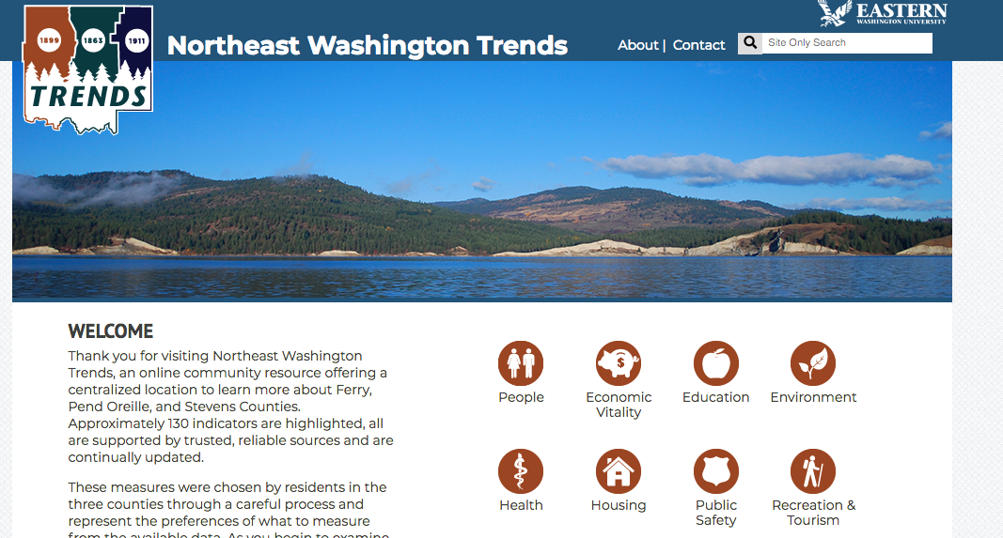
Findings: Other data sources for localities

Slide 19
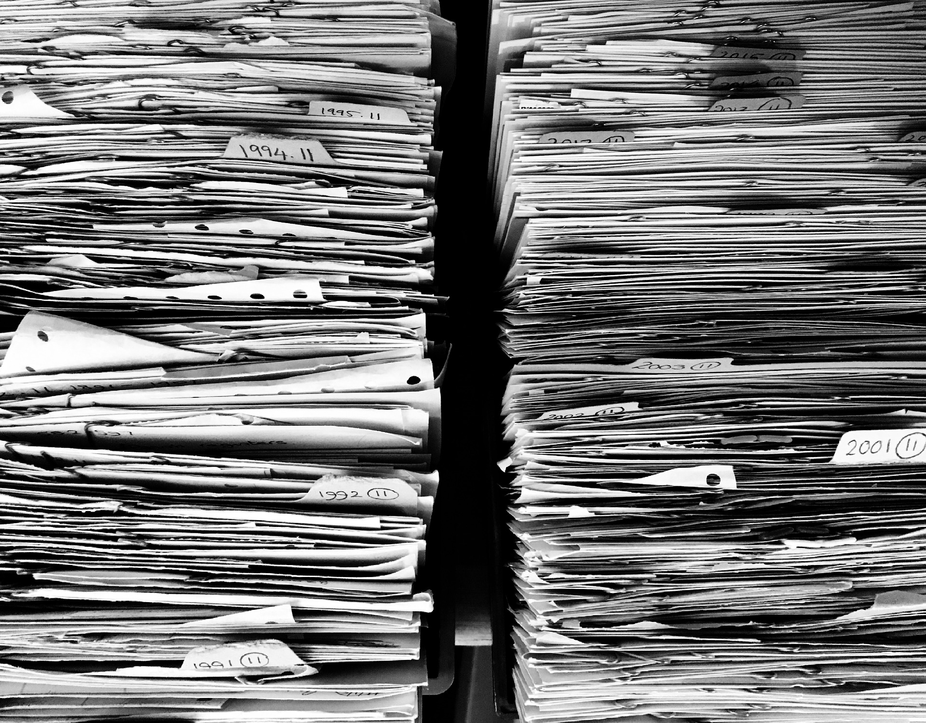
Findings: Many localities still working on basic info management
Recent records management grants through the Washington State Archives showed,
Half of grants awarded were simply to organize paper records, or get them off the floor.
Grants for technology most often went for software to manage the records requests – not get the records themselves online.

Slide 20
Which leads us to …
How might the Washington State Library support open data through public libraries?

Slide 21
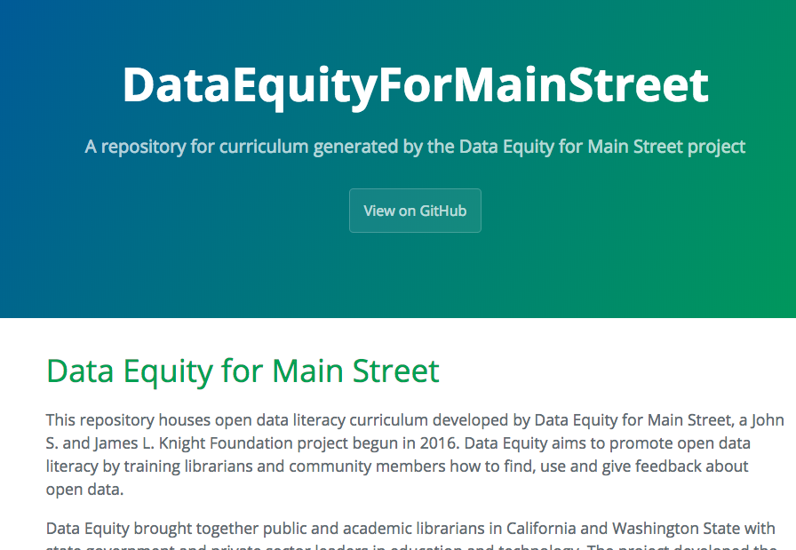
Recommendations: Create open data resource guide
Create a Lib Guide, a one-stop resource for curriculum, toolkits, collections of high-quality open data and tips about how to get started with open data publishing, use, instruction and advising.
Help develop e-curriculum that can be embedded in a library site or open portal.
Visit areas where libraries work closely with local agencies, or where local agencies are trying to work openly.

Slide 22
Recommendations: Provide the platform
The State Library should explore options for providing a state platform for local open data publishing
This eliminates a major roadblock and frees up libraries to work with governments on publishing high-quality data that the public wants

Slide 23
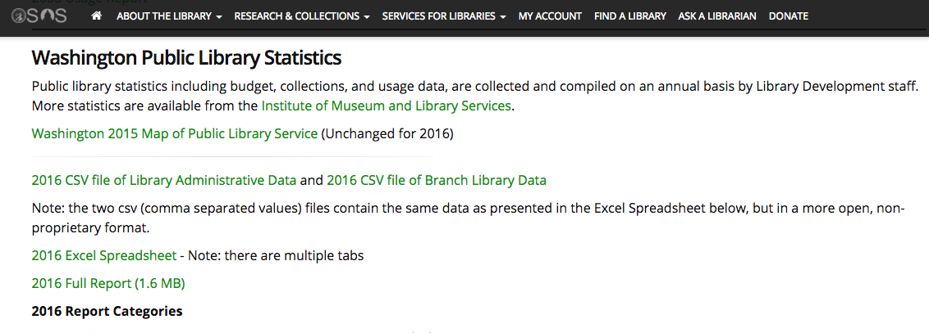
The State Library has already raised its game

Slide 24
Questions?
Read the report and view supporting materials at my GitHub repository:
https://github.com/OpenDataLiteracy/WA-State-Library-2018
Contact Kathleen Sullivan: kesullivan591@gmail.com

